Slide 1
Predicting Trust and Preventing Losses with Analytics

Slide 2




Team Introduction
Quantum Consulting
Jared Jones
Manny Guevara
Sonal Jape
Tyler Trocchi

Slide 3
Agenda
Business Overview
Data Collection and Preparation
Data Exploration and Analysis
Model and Evaluation
Key Takeaways
Q&A

Slide 4

Business Overview
Business Requirements Summary:
Objective: Facilitate peer-to-peer loans by connecting borrowers with investors.
Investor Focus: Attract investors by ensuring loans are given to borrowers with a high likelihood of repayment.
Goal: Maintain high-quality borrower profiles to encourage investor trust and maximize returns.
Key Issues:
NPA (Non-Performing Assets) Mitigation: Prioritize due diligence in loan approvals to minimize loan defaults and reduce NPAs.
Risk Management: Enhance borrower evaluation processes to identify and support low-risk profiles effectively.
Notes:
PeerLoanKart is an NBFC (Non-Banking Financial Company) which facilitates peer to peer loan. It connects people who need money (borrowers) with people who have money (investors). As an investor, you would want to invest in people who showed a profile of having a high probability of paying you back
Key issues - Ensure NPAs are lower – meaning PeerLoanKart wants to be very diligent in giving loans to borrower

Slide 5
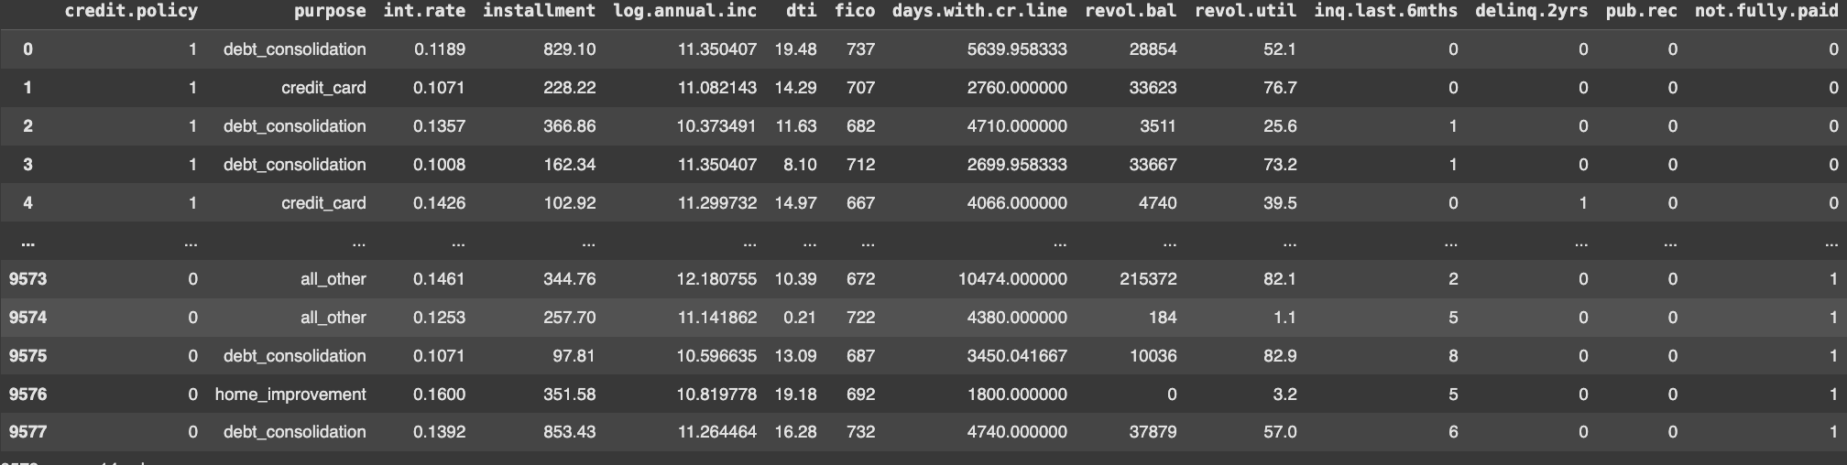
Data Collection
The dataset contains 9578 rows × 14 columns.
Notes:
credit.policy: 1 if the customer meets the credit underwriting criteria of PeerLoanKart, and 0 otherwise
purpose: The purpose of the loan (takes values "credit_card", "debt_consolidation", "educational", "major_purchase", "small_business", and "all_other")
int.rate: The interest rate of the loan, as a proportion (a rate of 11% would be stored as 0.11). Borrowers judged by PeerLoanKart to be more risky are assigned higher interest rates
installment: The monthly installments owed by the borrower if the loan is funded
log.annual.inc: The natural log of the self-reported annual income of the borrower
dti: The debt-to-income ratio of the borrower (amount of debt divided by annual income)
fico: The FICO credit score of the borrower
days.with.cr.line: The number of days the borrower has had a credit line
revol.bal: The borrower's revolving balance (amount unpaid at the end of the credit card billing cycle)
revol.util: The borrower's revolving line utilization rate (the amount of the credit line used relative to total credit available)
inq.last.6mths: The borrower's number of inquiries by creditors in the last 6 months
delinq.2yrs: The number of times the borrower had been 30+ days past due on a payment in the past 2 years
pub.rec: The borrower's number of derogatory public records (bankruptcy filings, tax liens, or judgments)
not.fully.paid: This is the output field. Please note that 1 means borrower is not going to pay the loan completely

Slide 6
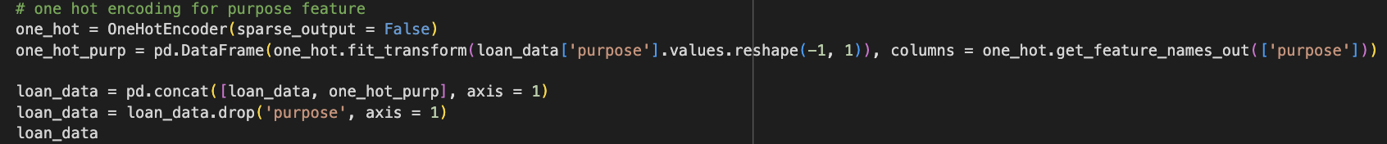
Data Preprocessing
No missing values
One hot encoded the ‘purpose’ feature, which gives the reason for taking out a loan for a total of 20 columns.
Notes:
purpose_all_other
purpose_credit_card
purpose_debt_consolidation
purpose_educational
purpose_home_improvement
purpose_major_purchase
purpose_small_business

Slide 7
Exploratory Data Analysis

Slide 8
Data Transformation
We used the Yeo-Johnson transform to normalize highly skewed features, reducing the effect of outliers on the logistic regression and SVM model.
Used ANOVA for feature selection: selected features with the 5, 10, and 15 highest ANOVA f-value scores.

Slide 9
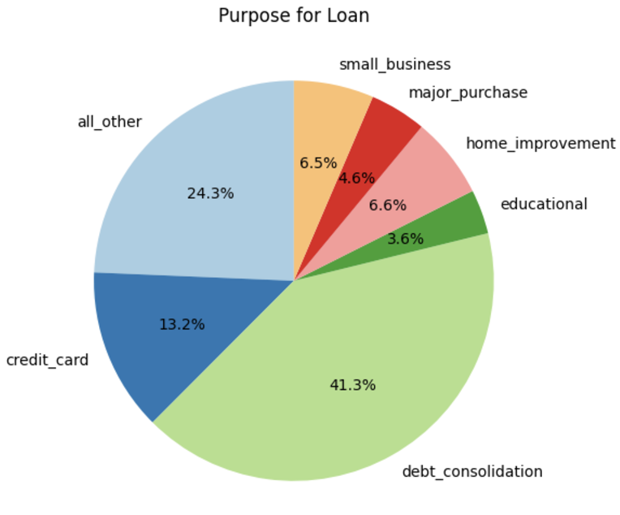
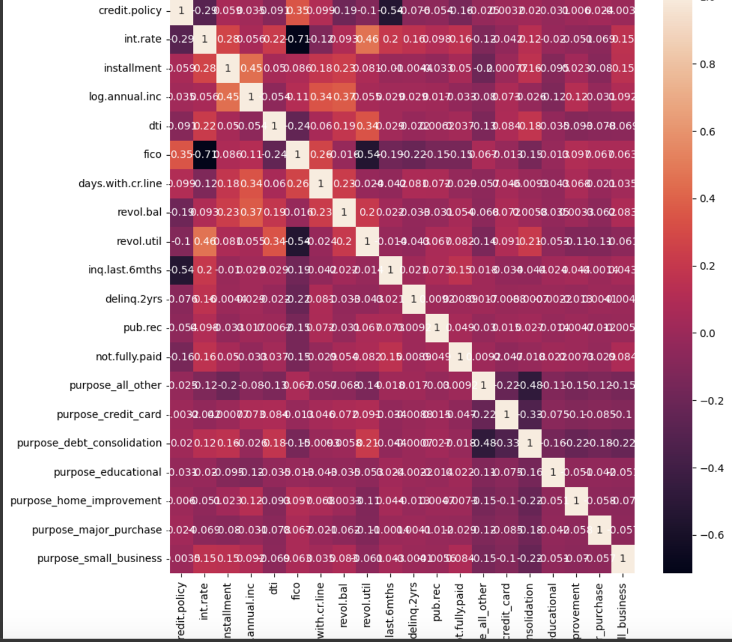
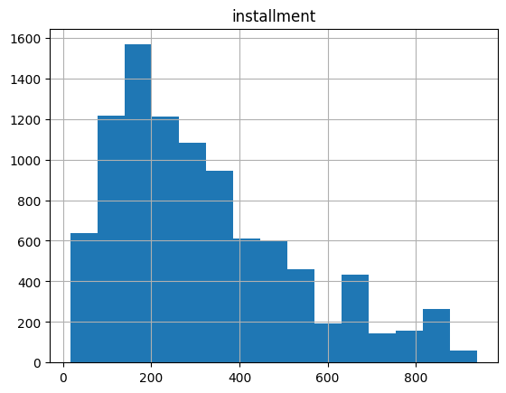
EDA Graphs

Slide 10
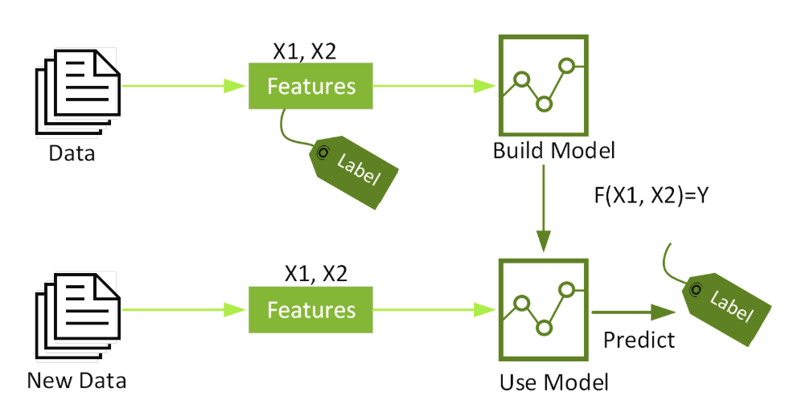
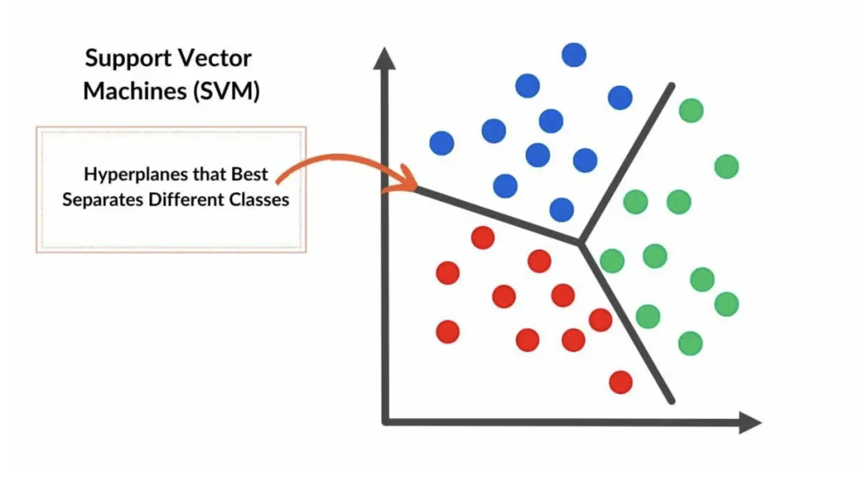
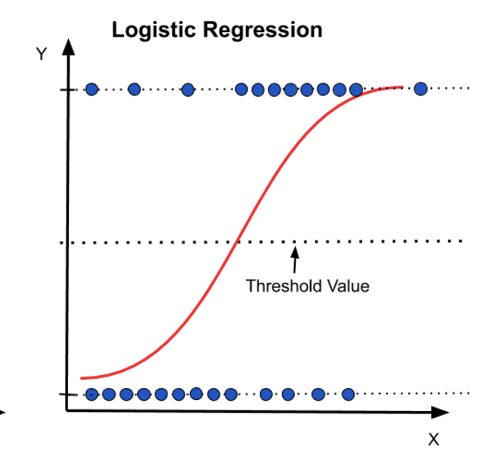
Our Approaches
XGBoost Classifier
Support Vector Machines
Logistic Regression

Slide 11
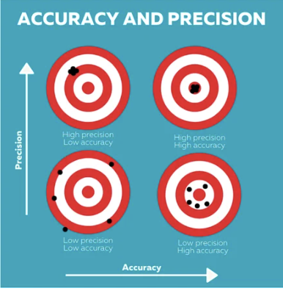


XGBoost Classifier
1. High Performance and Accuracy
2. Speed and Scalability
3. Versatility and Robustness
Notes:
Elaborate on these slides, IRL

Slide 12

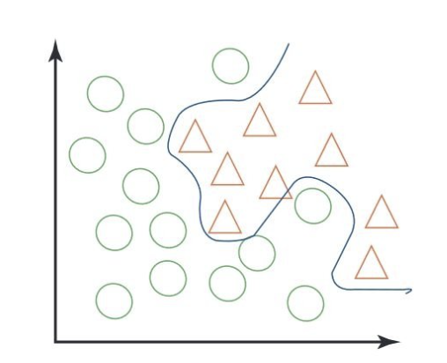
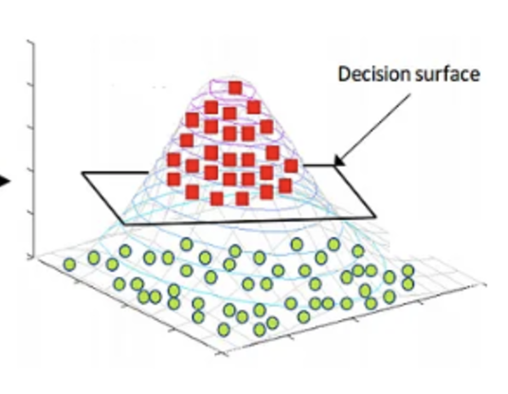
Support Vector Machines
1. Effective for High-Dimensional Data
2. Robust to Overfitting
3. Versatility with Kernels
Notes:
Elaborate on these slides, IRL

Slide 13
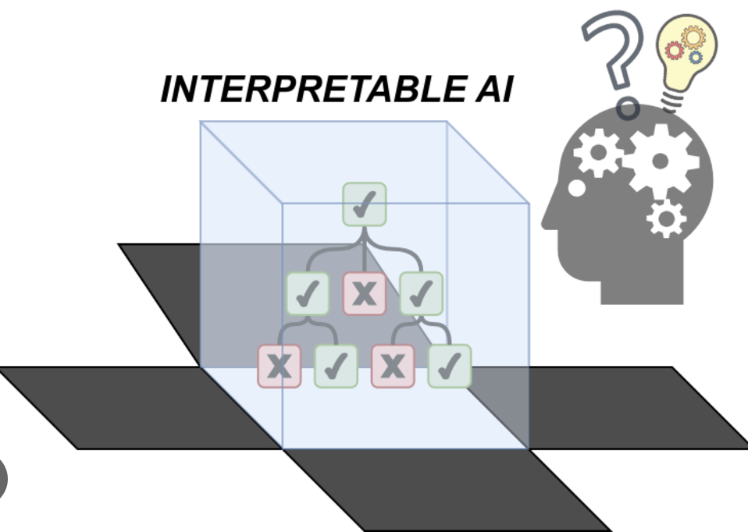

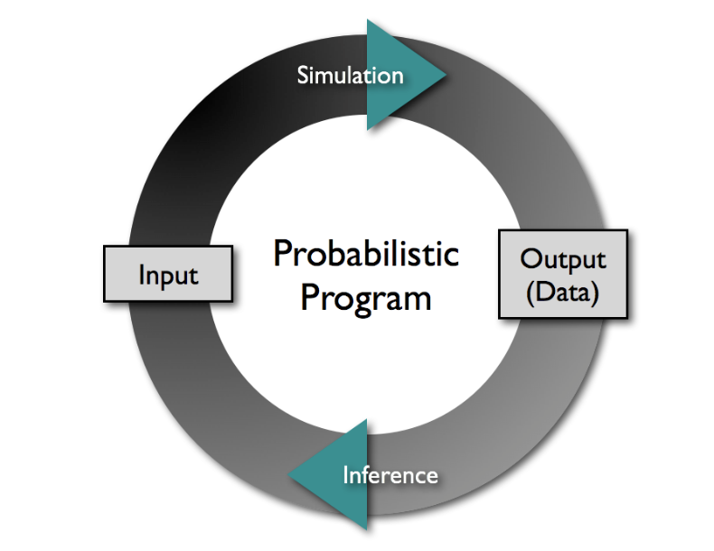
Logistic Regression
1. Simplicity and Interpretability
2. Efficiency and Speed
3. Probabilistic Output
Notes:
Elaborate on these slides, IRL

Slide 14
Evaluations

Slide 15
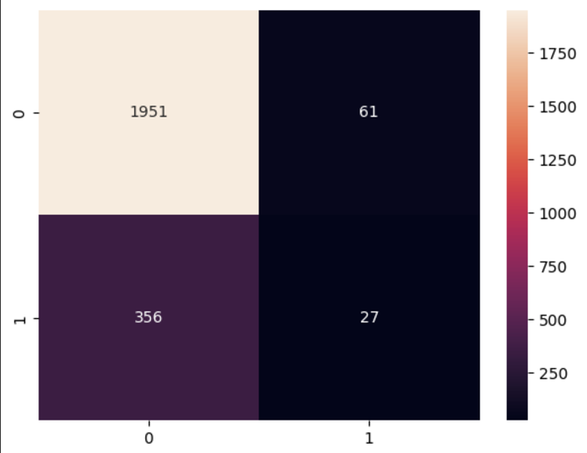
XGBoost Classifier Results
transformed
model: <class 'xgboost.sklearn.XGBClassifier'>
features: ['credit.policy', 'int.rate', 'installment', 'log.annual.inc', 'dti', 'fico', 'days.with.cr.line', 'revol.bal', 'revol.util', 'inq.last.6mths', 'delinq.2yrs', 'pub.rec', 'purpose_all_other', 'purpose_credit_card', 'purpose_debt_consolidation', 'purpose_educational', 'purpose_home_improvement', 'purpose_major_purchase', 'purpose_small_business']
accuracy: 0.8225469728601252
precision: 0.0835509138381201
f1 score: 0.130879345603272
recall: 0.3018867924528302
mean cross val score: 0.8217118997912317

Slide 16

Support Vector Machines Results
model: <class 'sklearn.pipeline.Pipeline'>
features: ['credit.policy', 'int.rate', 'installment', 'log.annual.inc', 'dti', 'fico', 'days.with.cr.line', 'revol.bal', 'revol.util', 'inq.last.6mths', 'delinq.2yrs', 'pub.rec', 'purpose_all_other', 'purpose_credit_card', 'purpose_debt_consolidation', 'purpose_educational', 'purpose_home_improvement', 'purpose_major_purchase', 'purpose_small_business']
accuracy: 0.8409185803757829
precision: 0.005221932114882507
f1 score: 0.01038961038961039
recall: 1.0
mean cross val score: 0.8384133611691024

Slide 17
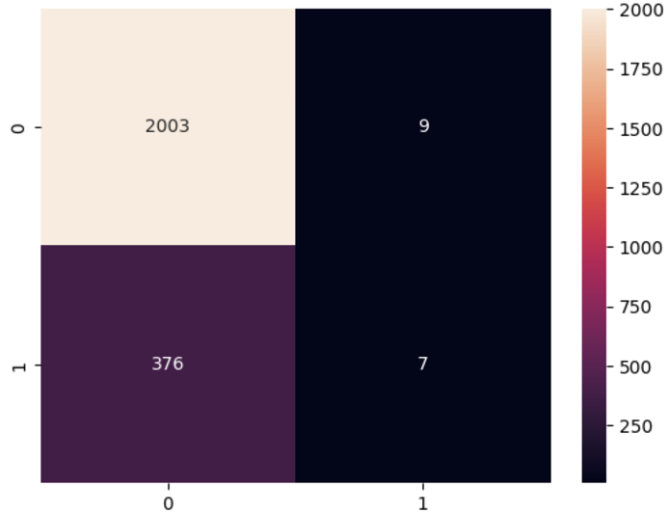
Logistic Regression Results
model: <class 'sklearn.pipeline.Pipeline'>
features: ['credit.policy' 'int.rate' 'installment' 'fico' 'revol.bal' 'revol.util'
'inq.last.6mths' 'pub.rec' 'purpose_credit_card' 'purpose_small_business']
accuracy: 0.8384133611691023
precision: 0.013054830287206266
f1 score: 0.02518891687657431
recall: 0.35714285714285715
mean cross val score: 0.8392484342379959

Slide 18
Key Takeaways
The res
The following findings were made during the project period.
1. SVM on the transformed data performed the best on recall score. SVMs consistently had the highest recall score.
2. XGBoost classifiers had the highest precision scores of about 8%, but none of the models performed particularly well in this area.
3. Logistic regression models had the highest f1 scores compared to the other models, with a value around 0.2.
Notes:
-Best score for issue at hand; example Recall Score because we want to know who will pay back! Highlight; Elaborate

Slide 19
Key Takeaways
The res
The following findings were made during the project period.
Machine learning can be used to predict whether a loan applicant will repay their loan with a high degree of accuracy.
The most important features for predicting loan repayment are the applicant's credit score, credit policy, interest rates, installments, annual income, and debt-to-income ratio.
More work needs to be done to increase the precision scores of the models. This could be solved by additional feature transformation or feature engineering.

Slide 20
Future Maintenance
The res
Performance: Periodically check the performance of the metrics to help identify any potential issues, paying special attention to the precision value.
Helps identify issues such as model drift, which could decrease the accuracy of the model
Monitoring Data Distribution: Help identify data drift; check input data distribution over time to ensure training data represents the current state of the problem.

Slide 21
Q&A

Slide 22
Thank You For Your Time!

